Slide 1
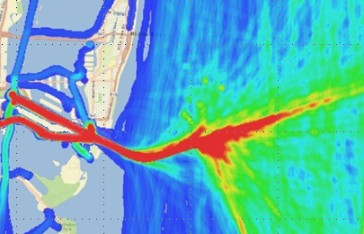


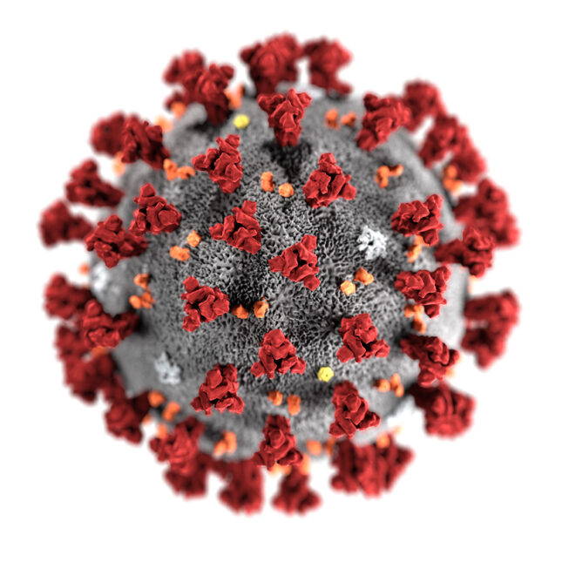


Project Overview
To observe the correlation between parameters responsible for generation of various pollutants e.g, NO₂
Approach
Investigating the relationship between NO₂ and ship trajectory, based on TROPOMI, U.S. AIS ship data, and ERA5 hourly wind data.
Obtaining various parameters from the sources provided to find the correlation between them using multivariate analysis.
Once those parameters are found, the Neural Network can be trained to check whether the model is able to learn the complexity between those parameters.
This trained model can then be used to observe the pollutants parameters in other region as well.
Ship Traffic Data
Satellite Data
(NO2, SO2)
COVID-19 Cases
Ship Pollution
Weather Data
Notes:
Please use SlideShow

Slide 2
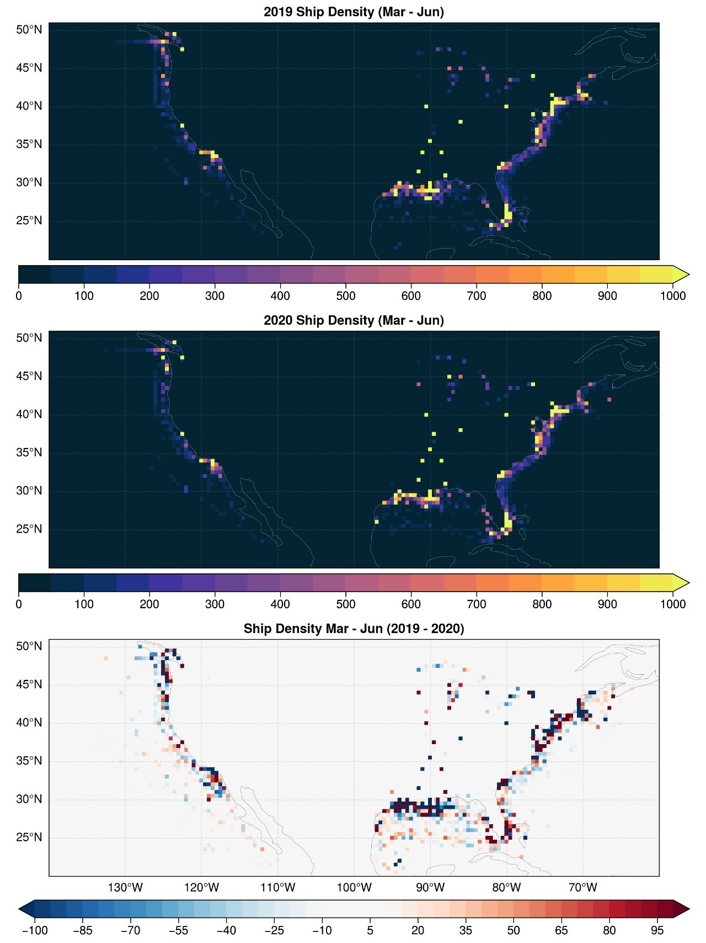
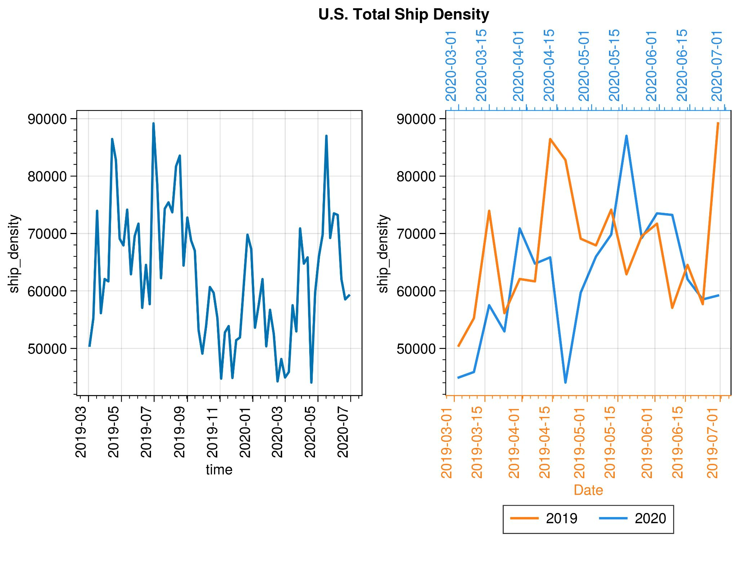
Effects of COVID-19 on ship density and NO₂
U.S. Total Ship density
The ship density near the coast decreased during the pandemic, but increased in the ocean.
The most significant different is between 04-15 and 05-15.
Seasonal pattern of ship density: more ships in spring and summer.

Slide 3
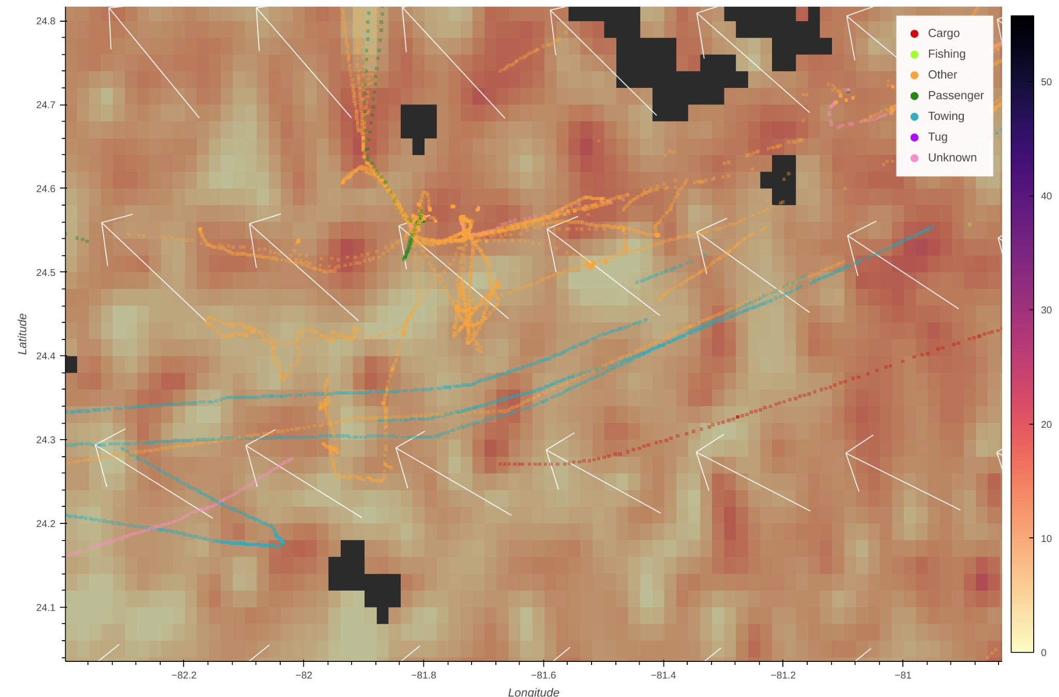
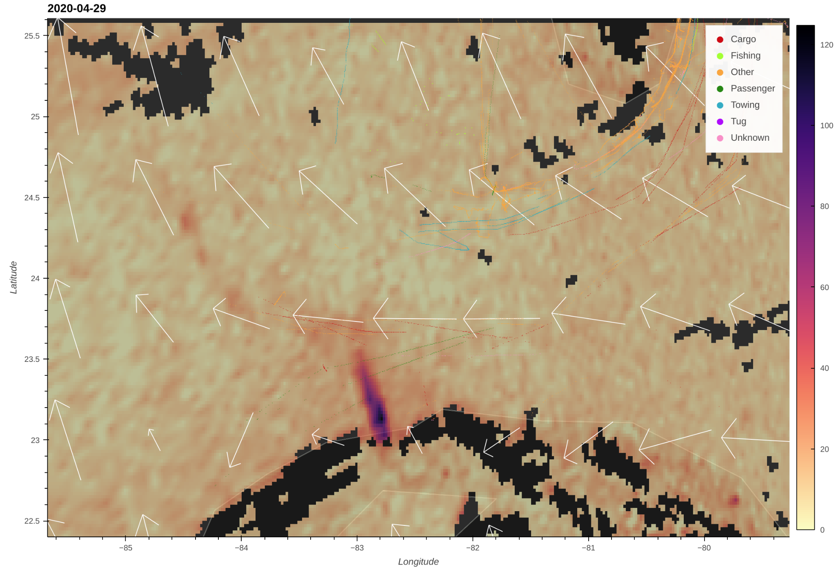
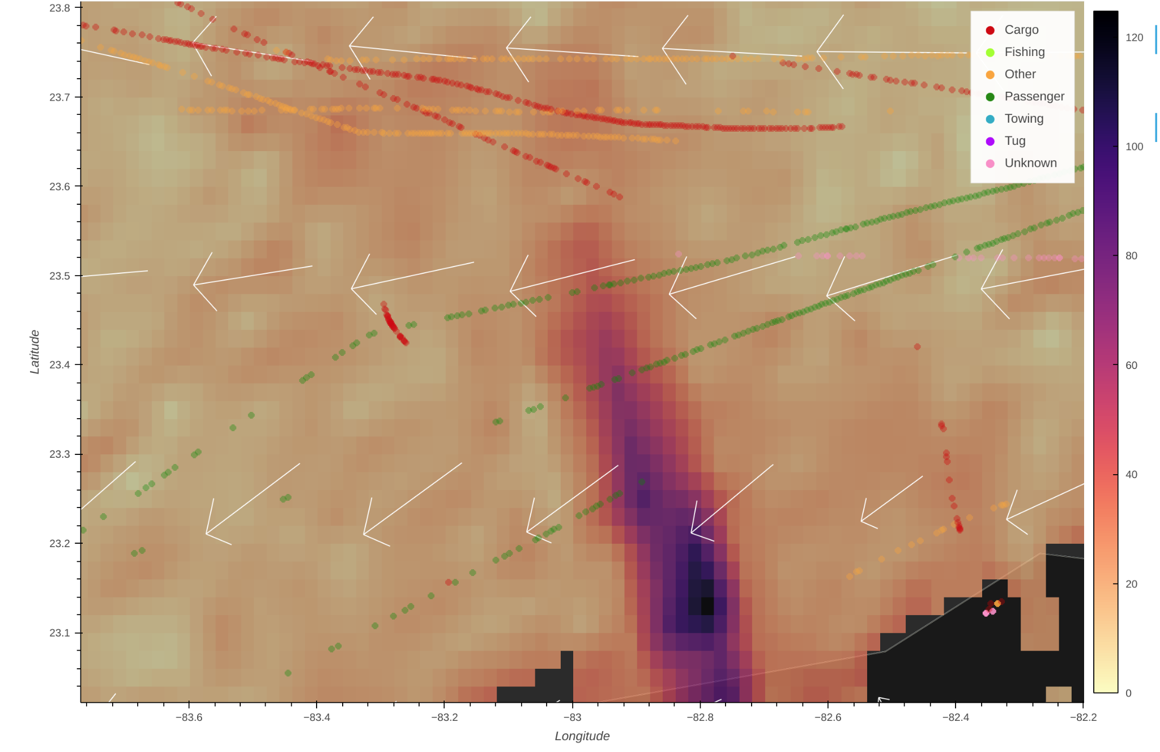
Patterns of ship and TROPOMI NO₂
Most high NO₂ pixels are ship emission
2020-04-29
Havana
New visualization tool: TROPOMI NO₂ + ERA5 wind
Ship AIS data (5 hours before TROPOMI overpass time)
Ship emission can be clearly seen in the “clean” ocean
Coastal NO₂ emission can cover the NO₂ emitted by ships
Clouds can lead to many missing pixel values (empty squares).
Ship emissions are mixed with the city polume

Slide 4
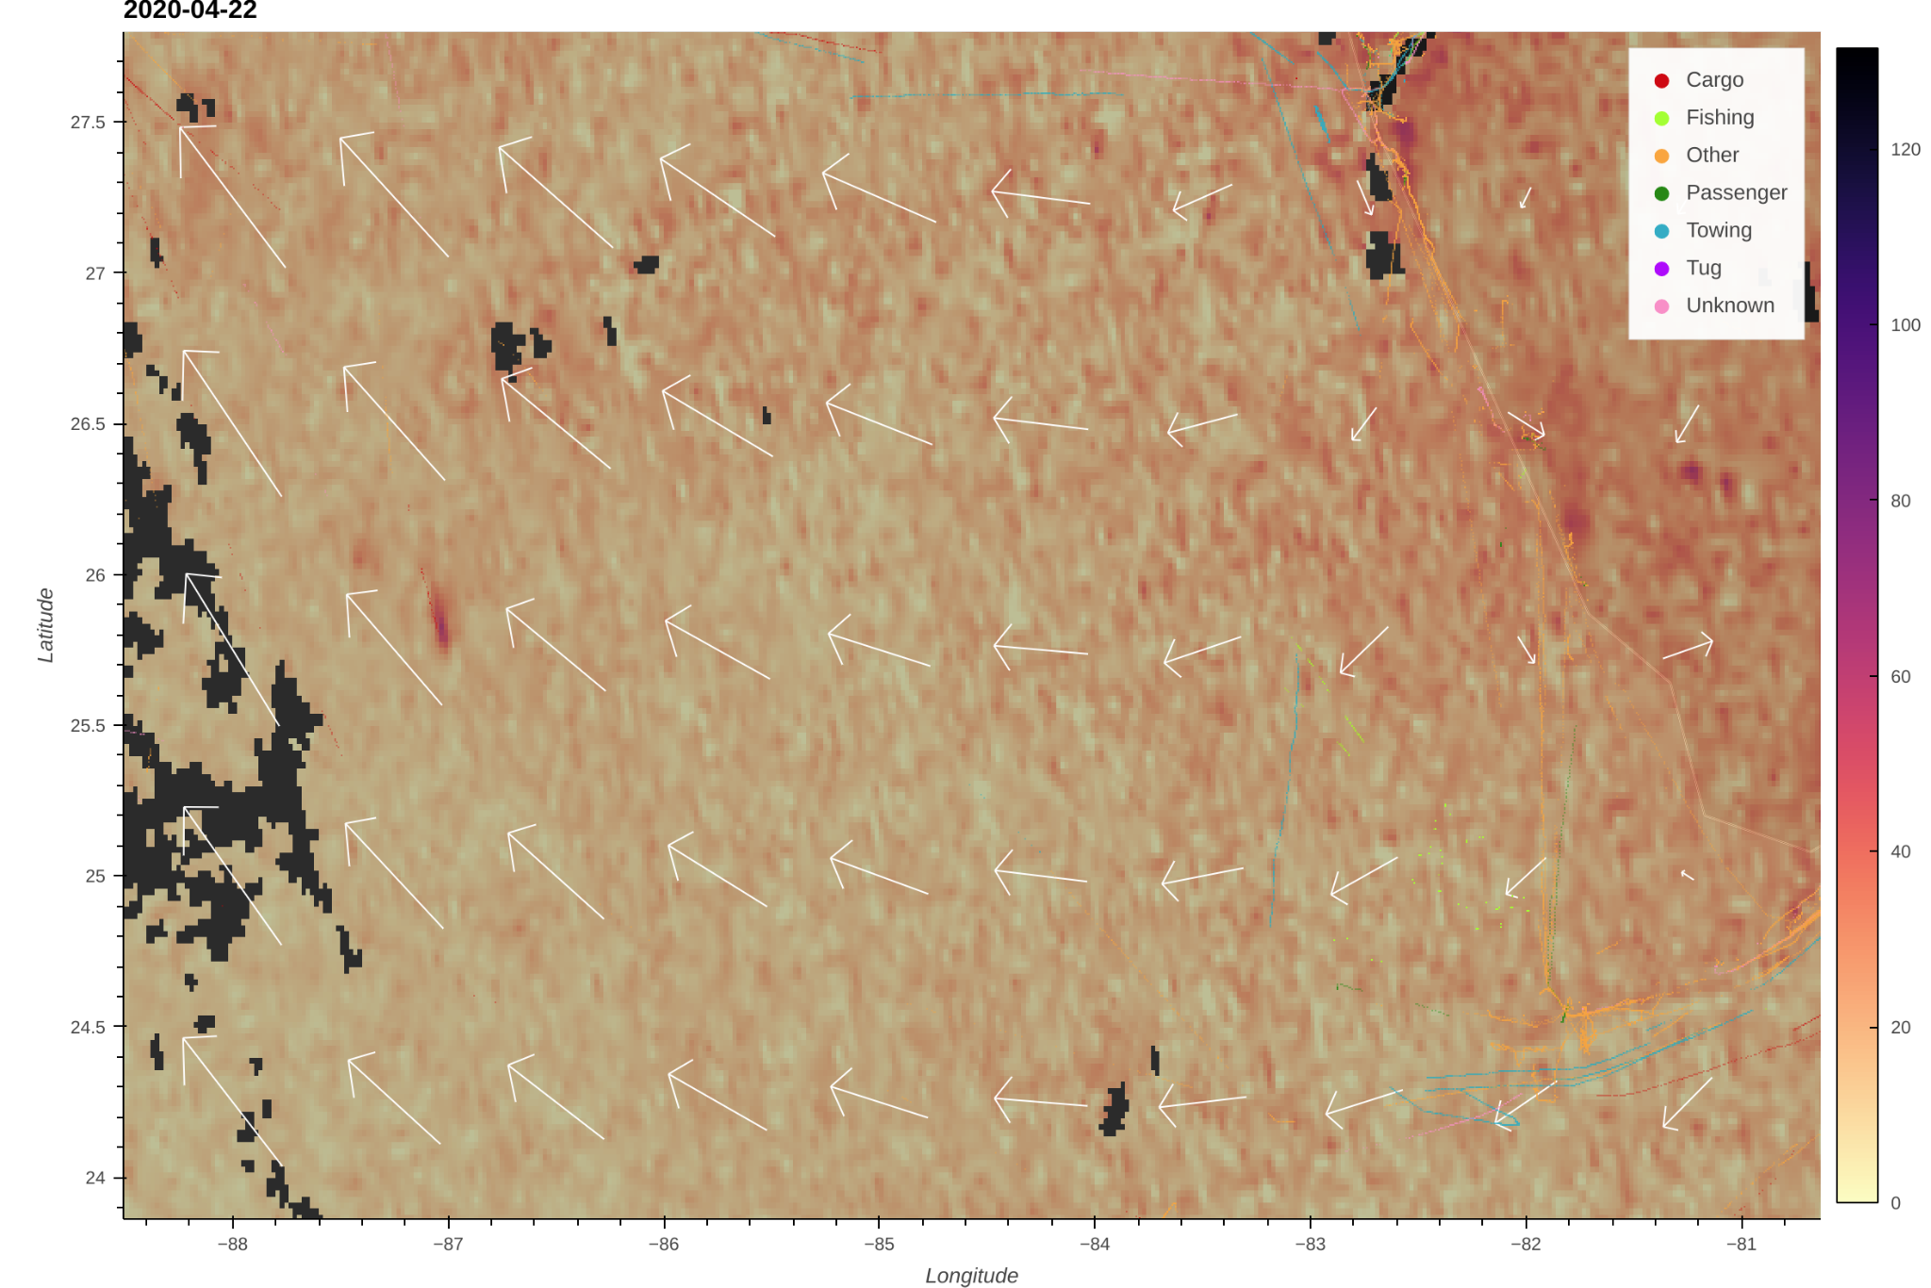
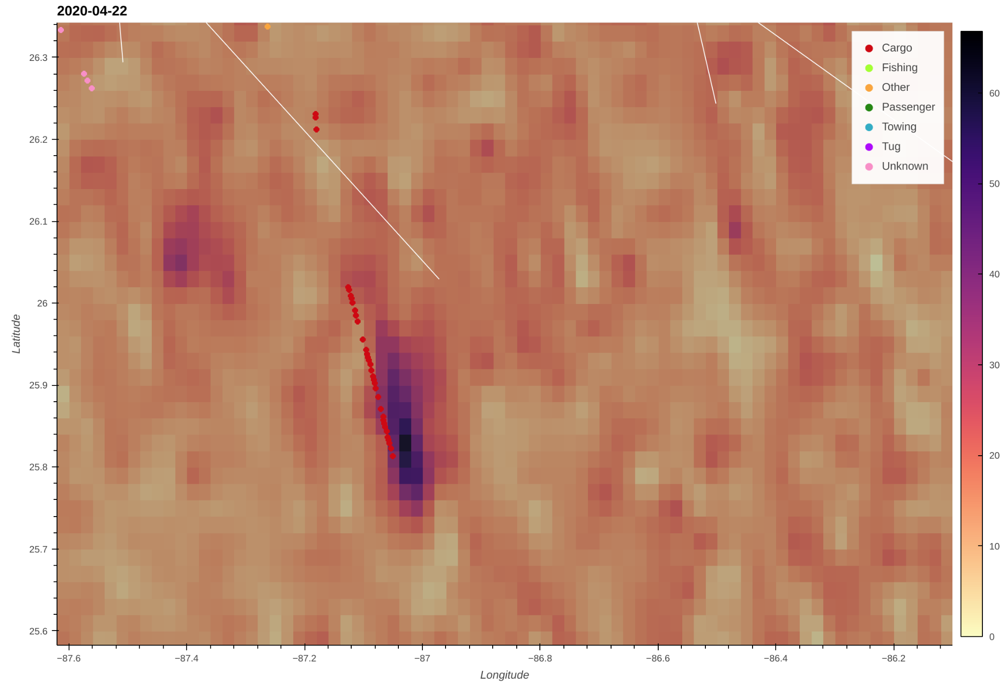
Effects of ship type on NO2 pollution
2020-04-22
Florida
The “Cargo” type ship can generate larger NO₂ pollution
Combing TROPOMI NO₂ and ship AIS data can give us new view of the ship emission, especially for different ship types

Slide 5
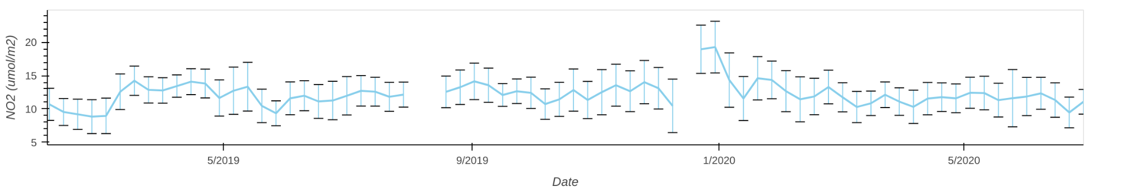
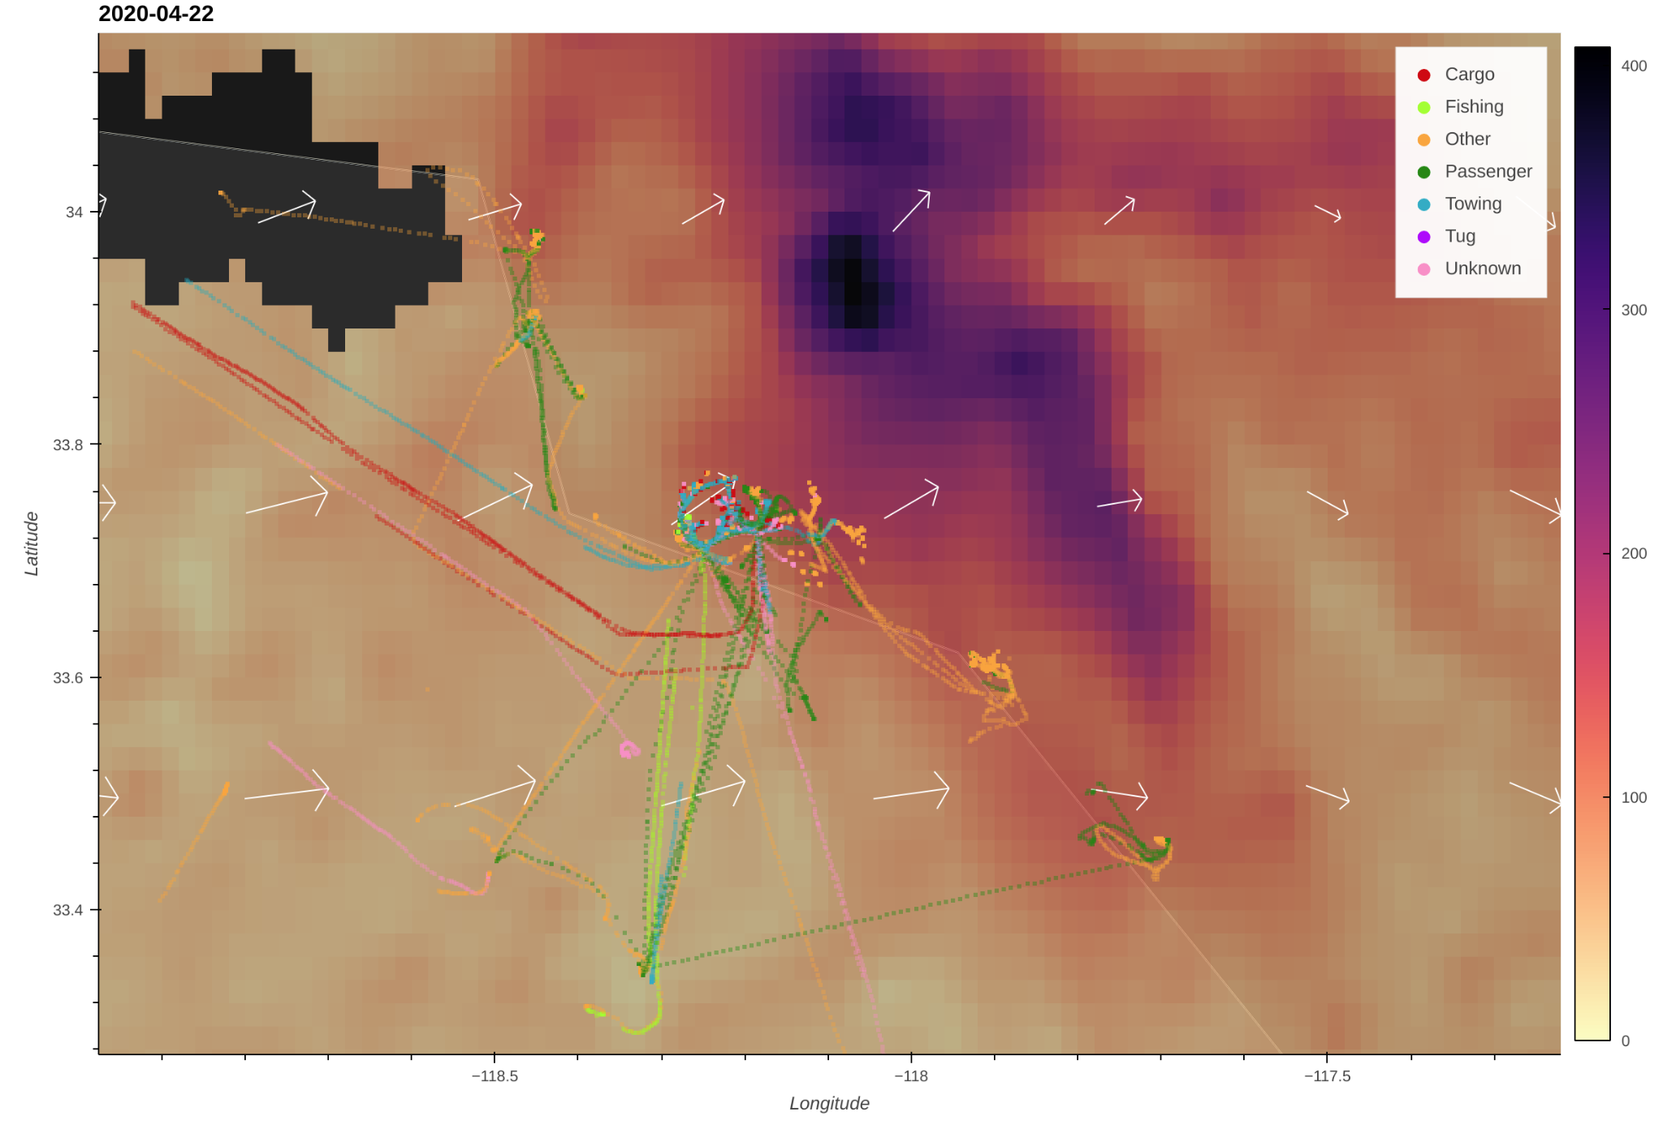
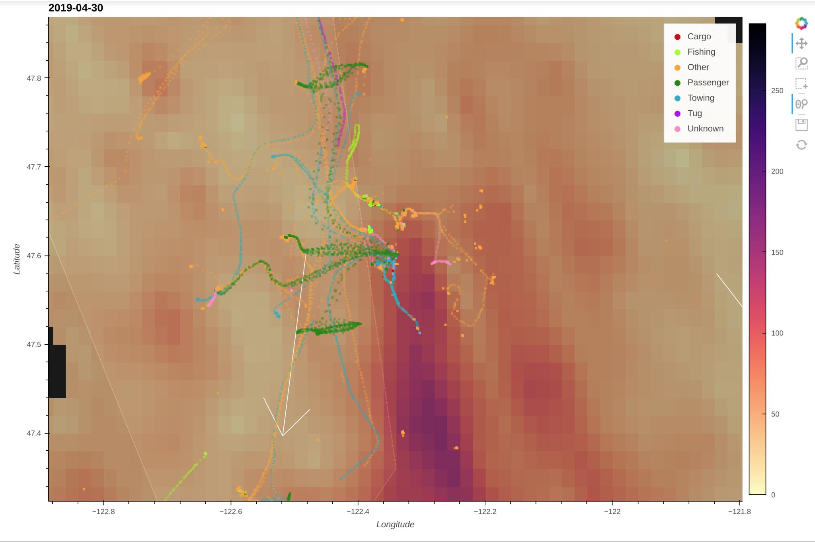
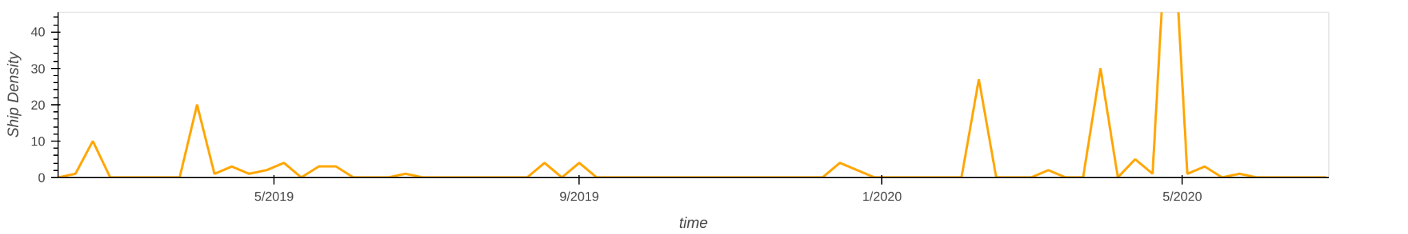
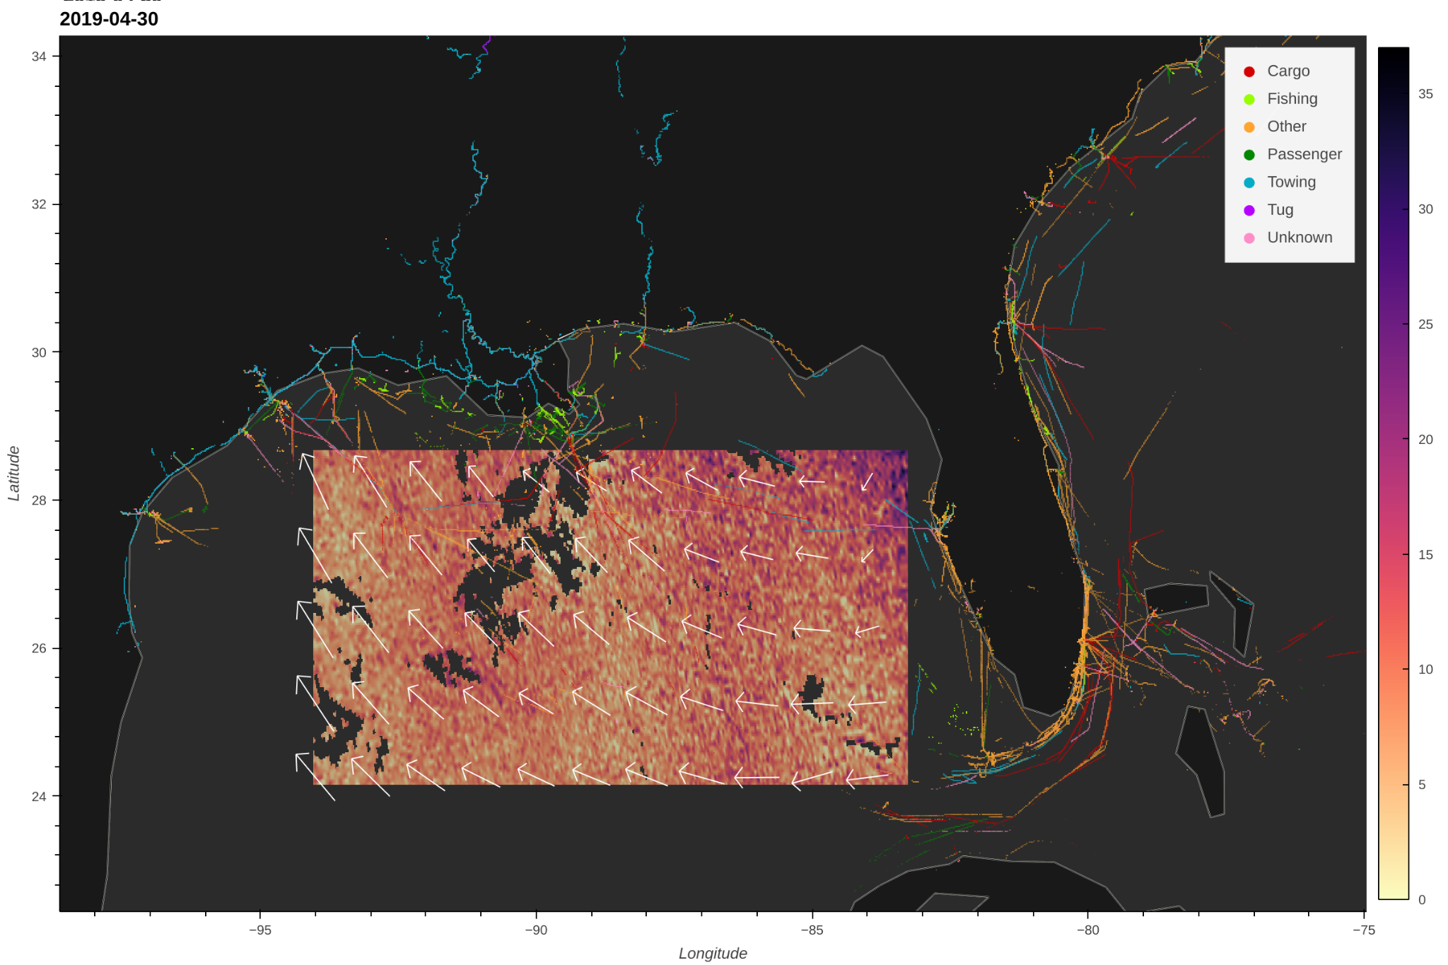
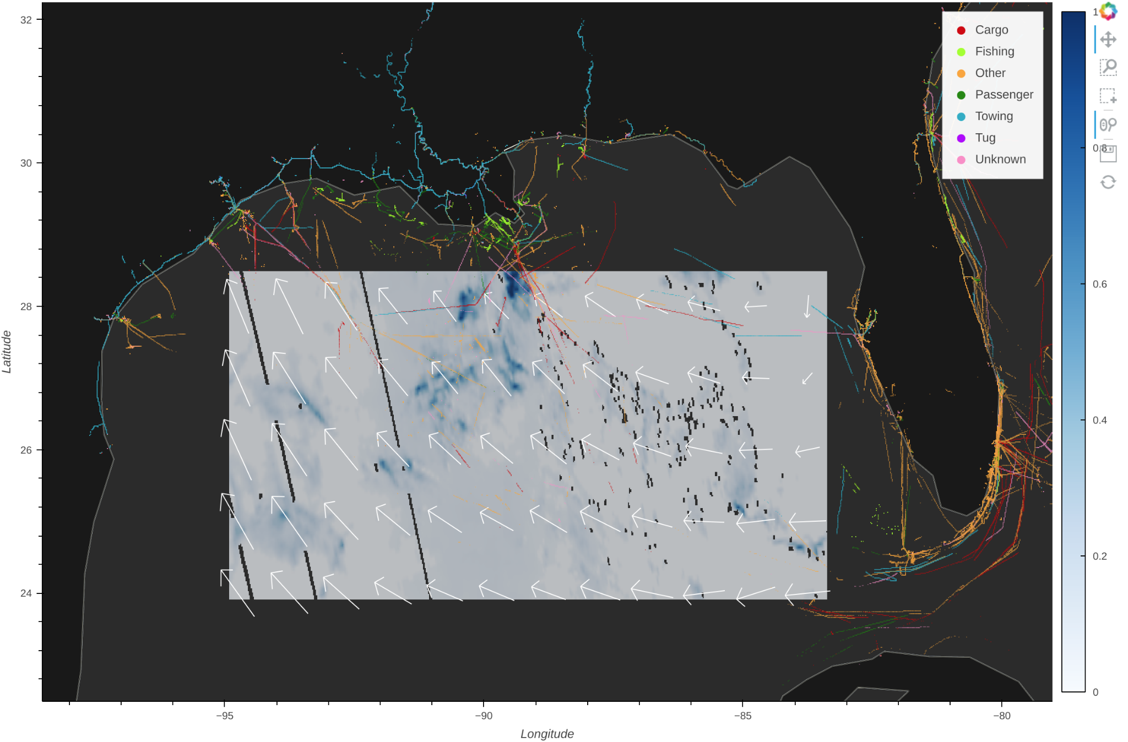
Effects of ship emission on populated area
Please enjoy our
ship visualization tool ;)
2020-04-22
2019-04-30
Victoria
Los Angeles
NO₂
Cloud Fraction
Everett
Because of the COVID-19, the ship emission can be partly seen near the populated cities, such as Los Angeles.
The NO2 generated by ships over the busy ports can be diluted by wind and bring to downwind cities.

Slide 6
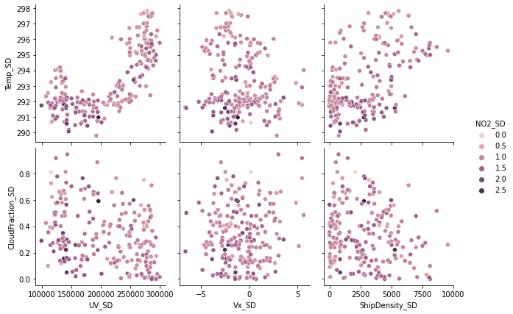
Multivariate Analysis
The temperature and UV concentrated over surface showed a positive correlation .
The data observations were less when Cloud Fraction (CF) value exceeded 0.6.
The NO2 were observed to be higher below certain temperatures.
The NO2 were observed between specific range of 10m wind especially at low velocity but no correlations were observed.
LIMITATIONS
Most of the NO2 values for CF > 0.85 weren’t present so to account that data, the NO2 concentrations were assumed to be 0.
Only the limited amount of parameters were taken into account to observe the changes in NO2.
Based on these observed parameters a simple neural network was built to determine the complexity which restricted the model performance.

Slide 7
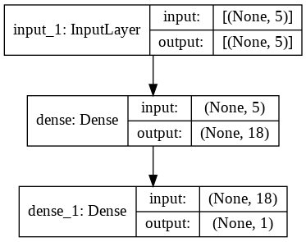
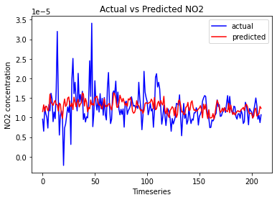
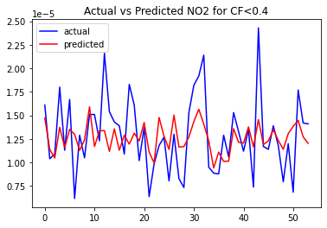
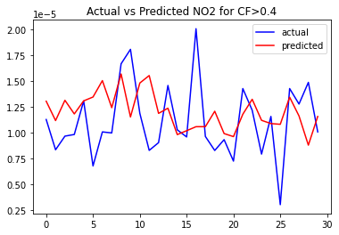
Neural Network Approach
A simple neural network was trained on the parameters based on the observations from multivariate analysis.
Input Parameters:<Ship Density, UV-b, wind velocity components, CF>
Output Parameters: <NO2 column densities>
The data accumulation was done for the duration of Dec 2019 to Jun 2020 away from the coastal region to avoid the NO2 pollution from land.
Model performance was not good due to less consideration of input, missing data values of NO2 and less consideration of optimization.

